Slide 1

Measurement of the Directional Characteristics of Antennas in the Testbed
19 Jan 2023
Master Thesis
By :
Chirag Patel

Slide 2
Connection flowchart
List of Hardware devices:
MXG Signal Generator
EXA Signal Analyser
Arcus stepper motor
List of software and API:
MatLab
Control Tool box (API)
GUI_CMD.exe
VISA protocol

Slide 3
MatLab
.mlapp
Application
Compare diff. data sets
Connect All
3 Devices
Get full access for control
Generate a live
Polar plot
Observe the
Data points
Choose the Range and Resolution with suggested Pause
Save Data

Slide 4
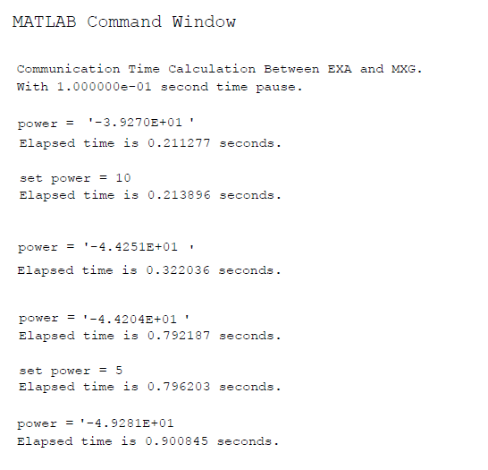
Communication time
Between MXG & EXA
0.1 sec Pause

Slide 5
Full rotation Time in seconds for the Motor
Total_Time = ( ( Micro_steps / (Pulse/sec) ) x ∆ Gear_size ) + setteling_Time(sec)
Required time for 1° step Size = Total_Time / 360°
Example :
Total_Time = ( ( 3200 / 1000 ) x 5 ) + 20
Total_Time = 16 + 20 = 36 (Sec)
Required time for 1° step Size = 36 / 360° = 0.1 Sec

Slide 6
Thank you

